Slide 1
FAKENEWS GROUP 1
Angela Bolchinova
Boyu Sui
Max Pike
Xi Yao
FAKE NEWS
An exploration of fake news online, specifically in relation to the contemporary specificity of media today and celebrity culture.

Slide 2
1
INTRODUCTION
&
RESEARCH QUESTIONS

Slide 3
AT THE START OF OUR JOURNEY
1. VIRAL
Successful news is defined by how far it reaches.
5. MEDIA COMPANIES
Profit Vs. Truth
2. GLOBAL
Fake news worldwide…
4. PARTIAL
Ulterior motives.
3. POPULARITY
How entertaining is it?
How shocking is it?
How different is it?

Slide 4
Can contemporary fake news be understood in regards to celebrity culture?
Can fake news be understood in the specificity of media today?
Why do people believe in lies so easily: the courage to hear the truth?

Slide 5
2
OVERVIEW
&
PLAN OF RESEARCH

Slide 6
OVERVIEW - METHODS
Textual methods
semiotics
textual environment
Visual methods
composition analysis
expert readings
Fake
News
Discourse analysis
documents
institutions
Ethnography
Field site
Digital ethnography
Digital methods
Live methods

Slide 7
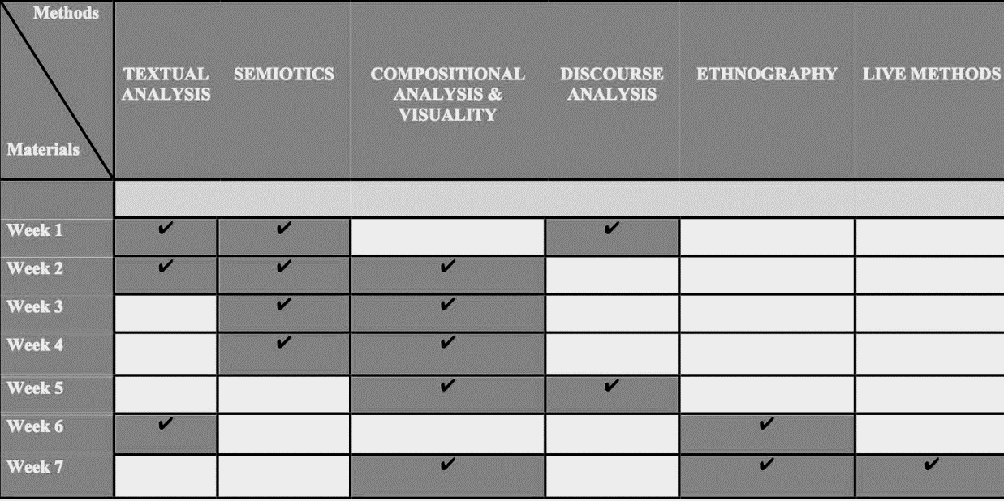
OVERVIEW - METHODS
VISUAL

Slide 8
OVERVIEW – RESEARCH BLOG
Questions, Theories, Approaches.
Live Methods.
Studying what people do with media.
Discourse analysis.
Thinking about viruality.
Engage or walk away?
Too important to ignore.
Week 1
Week 2
Week 3
Week 4
Week 5
Week 6
Week 7
Week 8
What is “Fake News”?
1. online text
Hillary/Trump
2. materialist ways
3. theoretical
approaches
1. semiotic analysis
“R.I.P” Cher
2. textuality
3. textual environment and its difference with semiotic analysis
1. contrasting visual images
Hillary/Cher
2. compositional analysis
3. explore the visuality
preliminary description of the institutional apparatuses
Q: Is “fake news” a product/example of us living in a “post-truth society”?
field sites:
place:
People
Things
(problem)
live methods analysis:
Design of Apple Website From 1996 to 2016
1. research questions
2. theoretical approaches

Slide 9
PLAN OF RESEARCH
Topic | Fake News
Background | False information spreads in news media today and influences celebrity activities.
Aim | To explore the influence on contemporary specificity of media today of fake news.
Step | Addendum.
Methodology | Textual analysis; Visual analysis; Discourse Analysis; Ethnography; Live methods;
TEXT
VISUAL

Slide 10
RESEARCH TIMETABLE
Research Activities | Researcher | Timescale | Deadline
Set up the group research digital portfolio; Write description of significance of “fake news”. | Max | 1 week | 26/Jan/2017
Find different online texts; List materialist ways and two different theoretical approaches; Describe own situations affect experience. | Angela | 1 week | 2/Feb/2017
Choose two contrasting texts and do a semiotic analysis; Describe the textuality. | Xi | 1 week | 9/Feb/2017
Choose two contrasting visual images and do a compositional analysis； Explore the visuality; Compare the result of them. | Boyu | 1 week | 16/Feb/2017
TEXT
VISUAL

Slide 11
RESEARCH TIMETABLE
Write a preliminary description of the institutional apparatuses, technologies and practices of audiencing that visually construct “fake news”. | Max | 1 week | 23/Feb/2017
List：three specific places which could be field sites; People who could meet; Things which could be observed as an ethnographer. | Boyu | 1 week | 2/Mar/2017
Write a brief outline describing some initial observations from Internet Archive Wayback Machine. | Xi | 1 week | 9/Mar/2017
Make a table of specific materials, places, people or things and suggest methods which would be appropriate to work with them； Put two best research questions on the blog along with discussion. | Angela | 3 days | 12/Mar/2017
Summarize and complete the research. | Angela Boyu Max Xi | 8 days | 20/Mar/2017
TEXT
VISUAL

Slide 12
3
ANALYSIS OF EXAMPLES

Slide 13
THE CHOICE OF EXAMPLES
Beginning
Research
Findings
Conclusion
What do we know?
Contemporary Media Speculation & Shock Practical Resolutions
Aims
Manipulation
Uncertainty
&
Chaos
Subjects
Celebrities Political Figures
Ordinary People
Behind the scenes
Weapons of Mass Deception
The Destructive Power of Lies

Slide 14
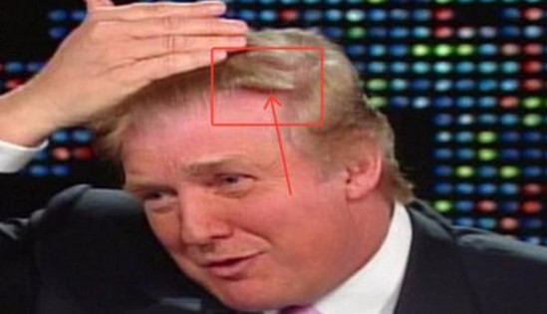
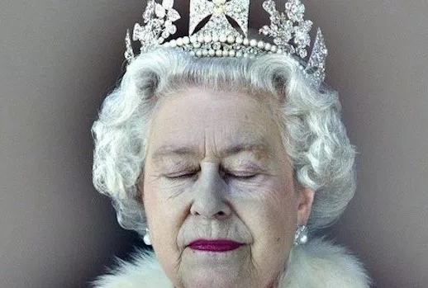

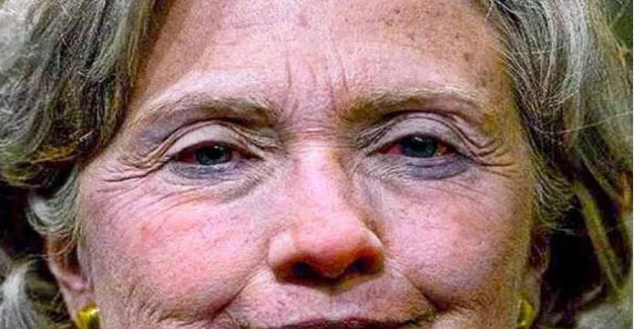
EXAMPLES ANALYSIS
MOCKERY
Donald Trump takes hair-growth drug.
FATALITY ​
‘RIP Cher’​
‘Donald Trump Dead’​
‘Queen Elizabeth II announced dead’
HEALTH AND ENTERTAINMENT
POLITICAL MANIPULATION​​
Terminal illnesses
Natural home remedies
Beauty and weight loss
Hillary Clinton is sick with pneumonia.

Slide 15
4
CONCLUSION

Slide 16
IMPLICATIONS
‘Fake news’ might be a product/example of us living in a ‘post-truth society’.
Reconsider
‘fake News’
Myth or Truth
Consumer Society
02
Through sharing to get inside cultures
Media,
Audience, Celebrity, ‘Fake News’
Individual’s participation in the (social) media to promote cultures.
01

Slide 17

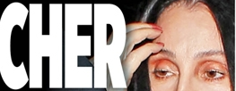

REMAINING PROBLEMS
Pick sources from social media, yellow magazine
Focus on fake news around ‘health’ of celebrities
All about entertainment
Discuss about celebrity culture and commercial culture
01
All about the West
02

Slide 18
THANK YOU

